Slide 1
Back-of-the Envelope Calculations: Investigating the Impact of Multicomponent Interactions on Solute Transport using High-Throughput Experiments
Laurianne Estrada, Jonathan A. Ouimet, Keshav K. Rangan, Shammah Lilonfe, Molly Dougher, Zhicheng Lu, Alexander Dowling, William Phillip
3.18.26

Slide 2
Back-of-the-Envelope Calculations
What are Back-of-the-Envelope (BOE) Calculations?
A quick calculation using simplified assumptions to estimate the value of a desired variable.
List known, estimated, and unknown variables
Make the simplest assumptions
Estimate unknown values & identify general trends
How is the transport of one ion influenced by the presence of competing ions in solution?
What transport mechanisms dominate the transport of each solute?
What physical understanding can be obtained about the transport of each solute?

Slide 3
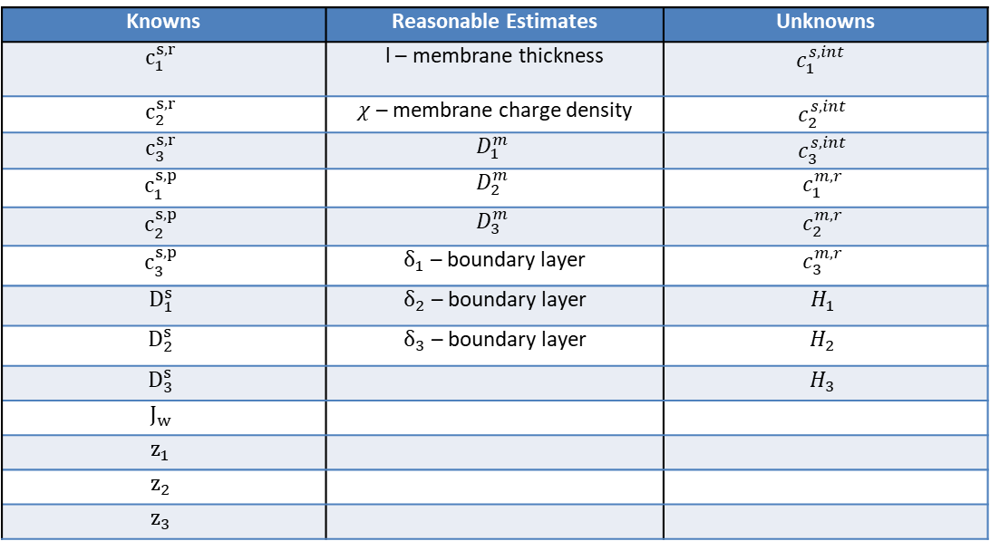
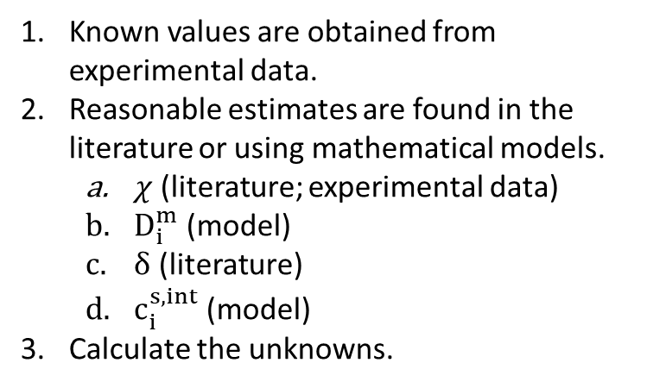
List known, estimated, and unknown variables
Knowns | Reasonable Estimates | Unknowns
$$c_{1}^{s,r}$$ | l – membrane thickness | $$c_{1}^{s,int}$$
$$c_{2}^{s,r}$$ | $χ$ – membrane charge density | $$c_{2}^{s,int}$$
$$c_{3}^{s,r}$$ | $$D_{1}^{m}$$ | $$c_{3}^{s,int}$$
$$c_{1}^{s,p}$$ | $$D_{2}^{m}$$ | $$c_{1}^{m,r}$$
$$c_{2}^{s,p}$$ | $$D_{3}^{m}$$ | $$c_{2}^{m,r}$$
$$c_{3}^{s,p}$$ | $δ_{1}$ – boundary layer | $$c_{3}^{m,r}$$
$$D_{1}^{s}$$ | $δ_{2}$ – boundary layer | $$H_{1}$$
$$D_{2}^{s}$$ | $δ_{3}$ – boundary layer | $$H_{2}$$
$$D_{3}^{s}$$ |  | $$H_{3}$$
$$J_{w}$$
$$z_{1}$$
$$z_{2}$$
$$z_{3}$$
Known values are obtained from experimental data.
Reasonable estimates are found in the literature or using mathematical models.
$χ$ (literature; experimental data)
$D_{i}^{m}$ (model)
$δ$ (literature)
$c_{i}^{s,int}$ (model)
Calculate the unknowns.

Slide 4

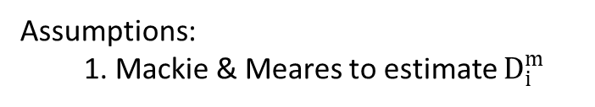


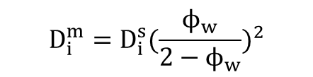

Make the simplest assumptions
Assumptions:
1. Mackie & Meares to estimate $D_{i}^{m}$
$$D_{i}^{m}=D_{i}^{s}{(\frac{ϕ_{w}}{2−ϕ_{w}})}^{2}$$
2. $D_{ij}$ is constant
$$J_{w}c_{p,1}^{s}=c_{1}^{s}J_{w}+∇c_{1}^{s}\left(D_{11}^{s}\right)+∇c_{2}^{s}\left(D_{12}^{s}\right)$$
$$J_{w}c_{p,2}^{s}=c_{2}^{s}J_{w}+∇c_{1}^{s}\left(D_{21}^{s}\right)+∇c_{2}^{s}\left(D_{22}^{s}\right)$$
$$\underline{\underline{D}} = \left[\begin{matrix}D_{11} & D_{12} \\ D_{21} & D_{22}\end{matrix}\right]$$
Use known solutions to single salt systems + eigenvalues/eigenvectors
$$\underline{\underline{D}} = \underline{\underline{t}} \underline{\underline{σ}} \underline{\underline{t^{−1}}}$$
t : column matrix with eigenvectors of D
σ: diagonal matrix with eigenvalues of D
$$\underline{\underline{c}} = \underline{\underline{t}} \underline{\underline{ψ}}$$
ψ: transformed concentration
The equations for the transformed concentration resemble that of Fick’s Second Law, which has the solution:
$$\frac{∂c_{i}}{∂t}=D\frac{∂^{2}c_{i}}{{∂z}^{2}}$$
↔
$$\frac{∂\underline{ψ}}{∂t}=\underline{\underline{σ}}\frac{∂^{2}\underline{ψ}}{{∂z}^{2}}$$
These relationships simplify the concentration polarization calculations for a multicomponent system, where no regress is needed.
$${Δc}_{i}=F(D,z,t)Δc_{i}^{0}$$
↔
$${Δ\underline{ψ}}_{i}=F(\underline{\underline{σ}},z,t)Δ{\underline{ψ}}_{i}^{0}$$

Slide 5
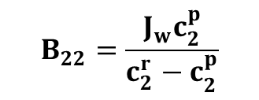
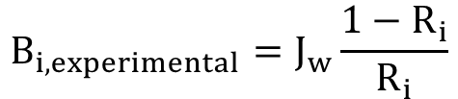
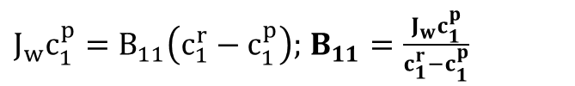
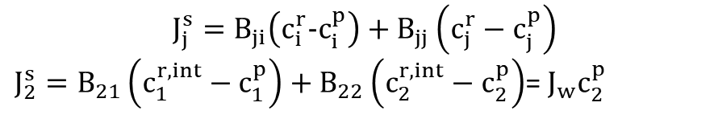
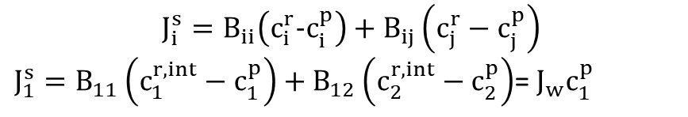
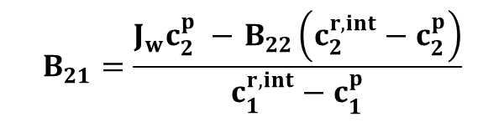
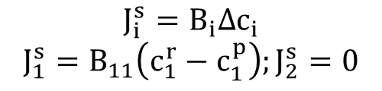
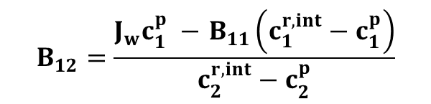
Make the simplest assumptions
Assumptions:
3. Diffusion only dominant transport mechanism
4. Take $B_{ij}$ as a lumped parameter. Using single-salt experiments is sufficient for obtaining $B_{ii} \&B_{jj}$ values
single salt:
multi salt:
$$J_{i}^{s}=B_{ii}\left(c_{i}^{r}−c_{i}^{p}\right)+B_{ij}\left(c_{j}^{r}−c_{j}^{p}\right)$$
$J_{1}^{s}=B_{11}\left(c_{1}^{r,int}−c_{1}^{p}\right)+B_{12}\left(c_{2}^{r,int}−c_{2}^{p}\right)$= $J_{w}c_{1}^{p}$
$$B_{i, experimental}=J_{w}\frac{1−R_{i}}{R_{i}}$$
$$J_{i}^{s}=B_{i}Δc_{i}$$
$$J_{1}^{s}=B_{11}\left(c_{1}^{r}−c_{1}^{p}\right);J_{2}^{s}=0$$
$$J_{j}^{s}=B_{ji}\left(c_{i}^{r}−c_{i}^{p}\right)+B_{jj}\left(c_{j}^{r}−c_{j}^{p}\right)$$
$J_{2}^{s}=B_{21}\left(c_{1}^{r,int}−c_{1}^{p}\right)+B_{22}\left(c_{2}^{r,int}−c_{2}^{p}\right)$= $J_{w}c_{2}^{p}$
$J_{w}c_{1}^{p}=B_{11}\left(c_{1}^{r}−c_{1}^{p}\right);$ $B_{11}=\frac{J_{w}c_{1}^{p}}{c_{1}^{r}−c_{1}^{p}}$
$$B_{12}=\frac{J_{w}c_{1}^{p} −{ B}_{11}\left(c_{1}^{r,int}−c_{1}^{p}\right)}{c_{2}^{r,int}−c_{2}^{p}}$$
$$B_{22}=\frac{J_{w}c_{2}^{p}}{c_{2}^{r}−c_{2}^{p}}$$
Repeating;
$$B_{21}=\frac{J_{w}c_{2}^{p} −{ B}_{22}\left(c_{2}^{r,int}−c_{2}^{p}\right)}{c_{1}^{r,int}−c_{1}^{p}}$$

Slide 6

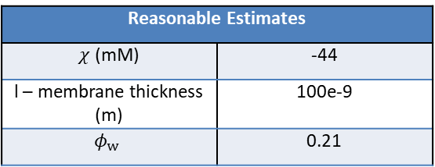

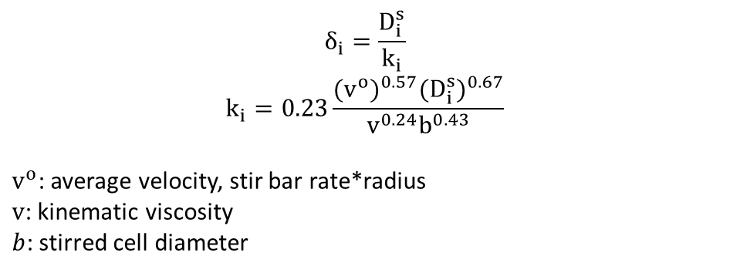
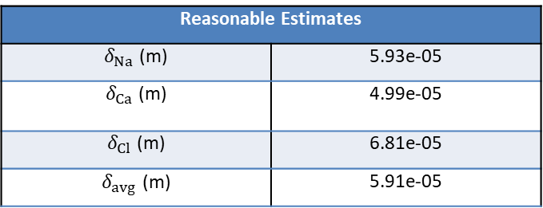
Estimate unknown values & identify general trends
Experiment: NF270_MC2_05.08.24_E1
Salts: NaCl, CaCl₂
1. Obtain known parameters from experimental data (BOX: Rejection_Analysis)
2. Calculate the reasonable estimates.
Reasonable Estimates
$χ$ (mM) | -44
l – membrane thickness (m) | 100e-9
$$φ_{w}$$ | 0.21
$$δ_{i}=\frac{D_{i}^{s}}{k_{i}}$$
$$k_{i}=0.23\frac{{(v^{o})}^{0.57}{(D_{i}^{s})}^{0.67}}{v^{0.24}b^{0.43}}$$
$v^{o}$: average velocity, stir bar rate*radius
$v$: kinematic viscosity
$b$: stirred cell diameter
Reasonable Estimates
$δ_{Na}$ (m) | 5.93e-05
$δ_{Ca}$ (m) | 4.99e-05
$δ_{Cl}$ (m) | 6.81e-05
$δ_{avg}$ (m) | 5.91e-05
*For now, $D_{i}^{m}$ estimates are not included.
3. Estimate $c_{ij}^{r,int}$, then B.
Notes:
NF270 DATA2: concentration of KCl in chi calculation was set to 10mM but was supposed to be 1mM. That is why the paper says -140mM but here it says -44mM.

Slide 7
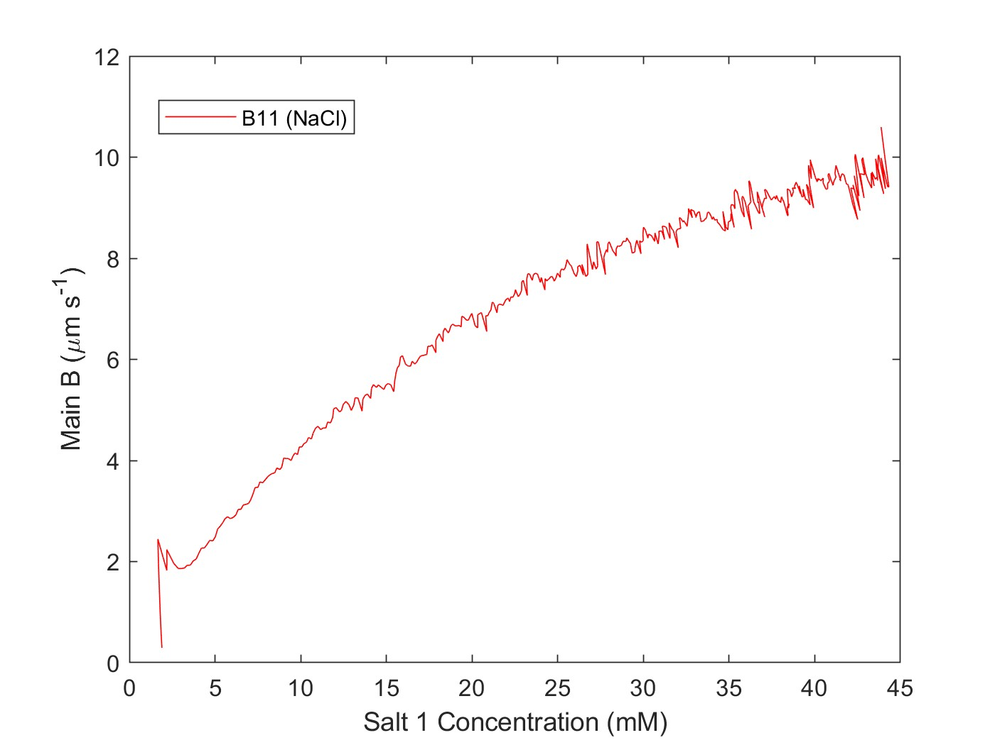
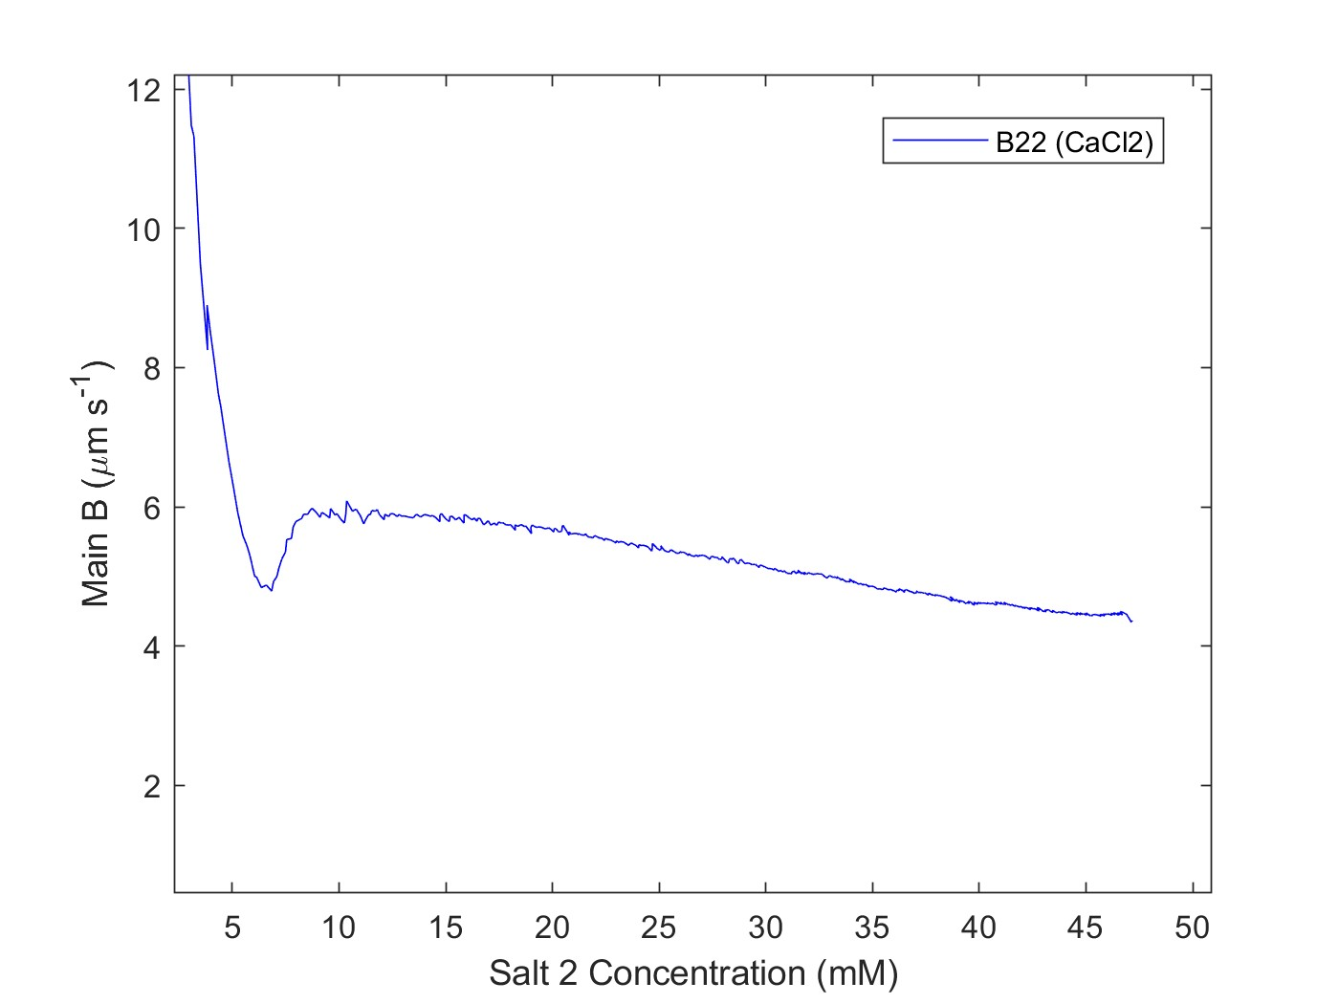
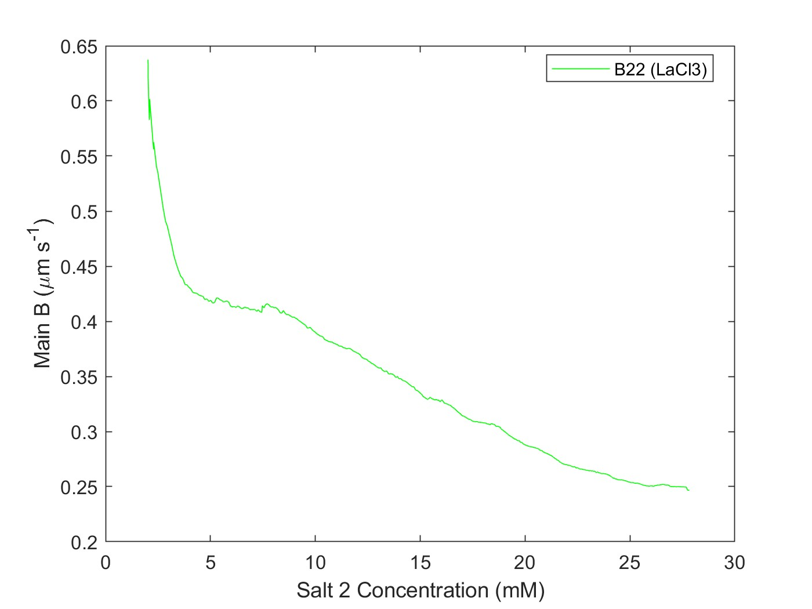
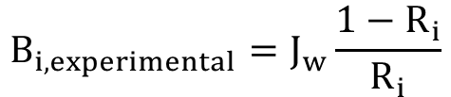
Estimate unknown values & identify general trends
Single salt experiments
Using conductivity data
$$B_{i, experimental}=J_{w}\frac{1−R_{i}}{R_{i}}$$
Notes:
NF270 DATA2: concentration of KCl in chi calculation was set to 10mM but was supposed to be 1mM. That is why the paper says -140mM but here it says -44mM.

Slide 8
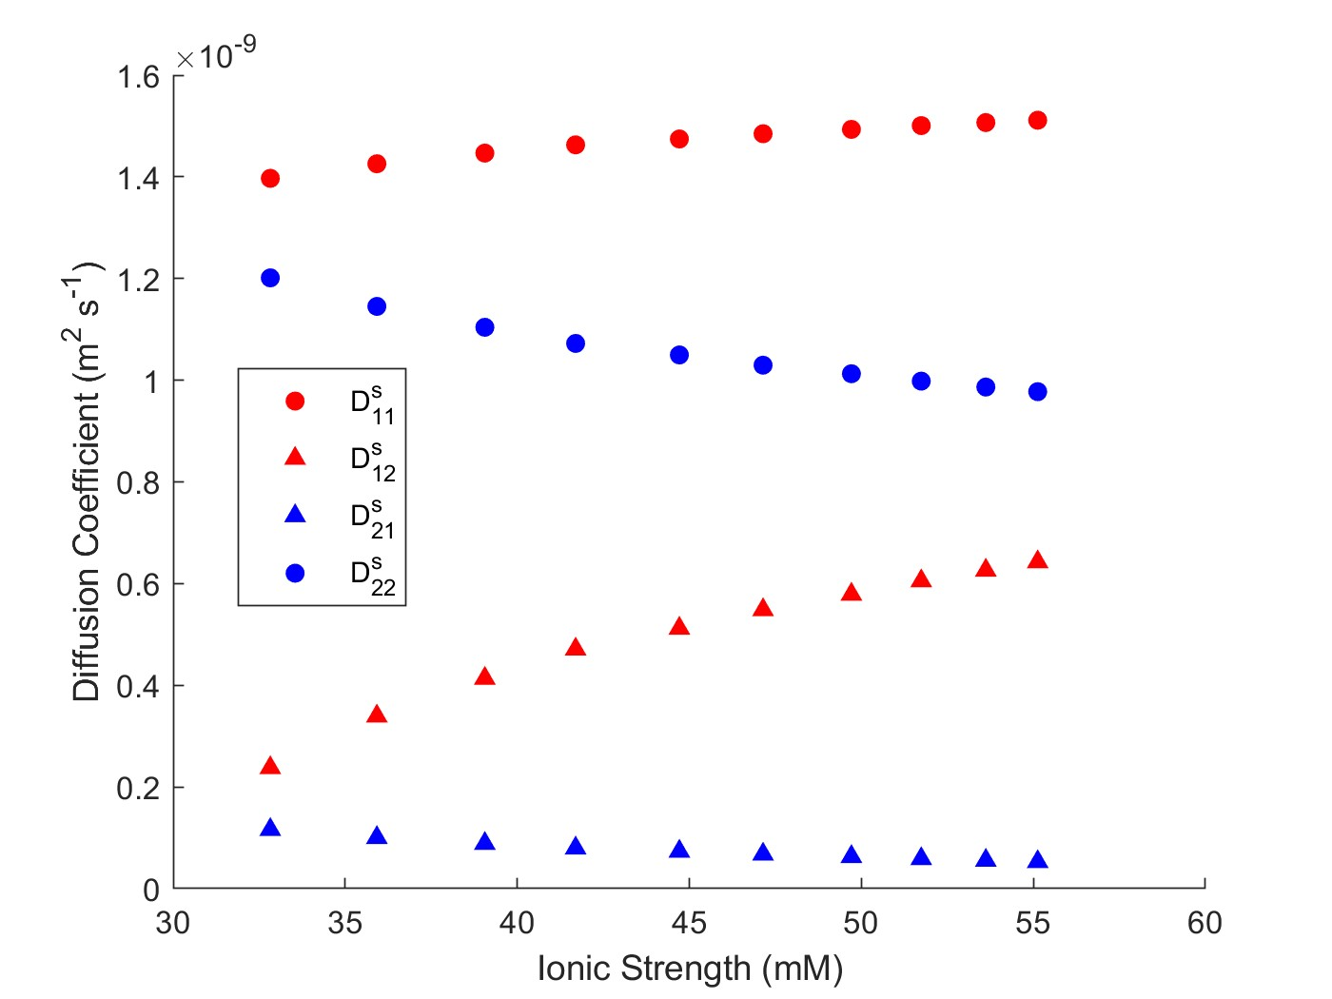
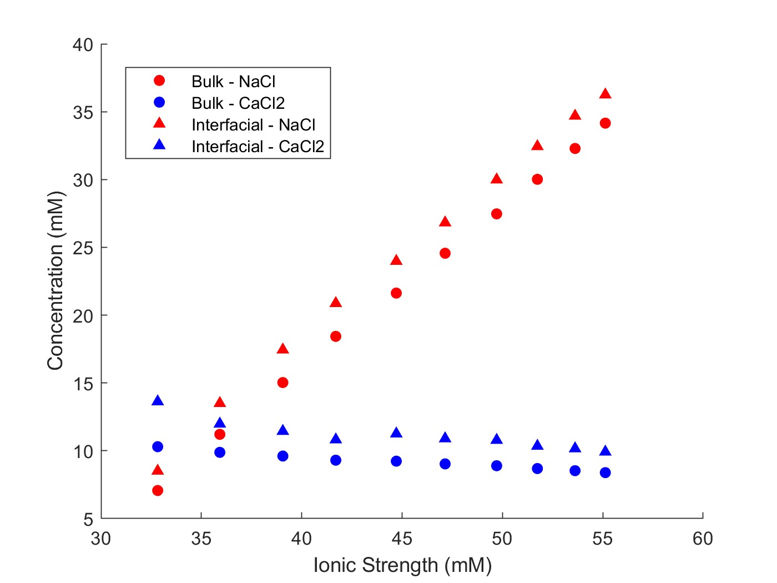
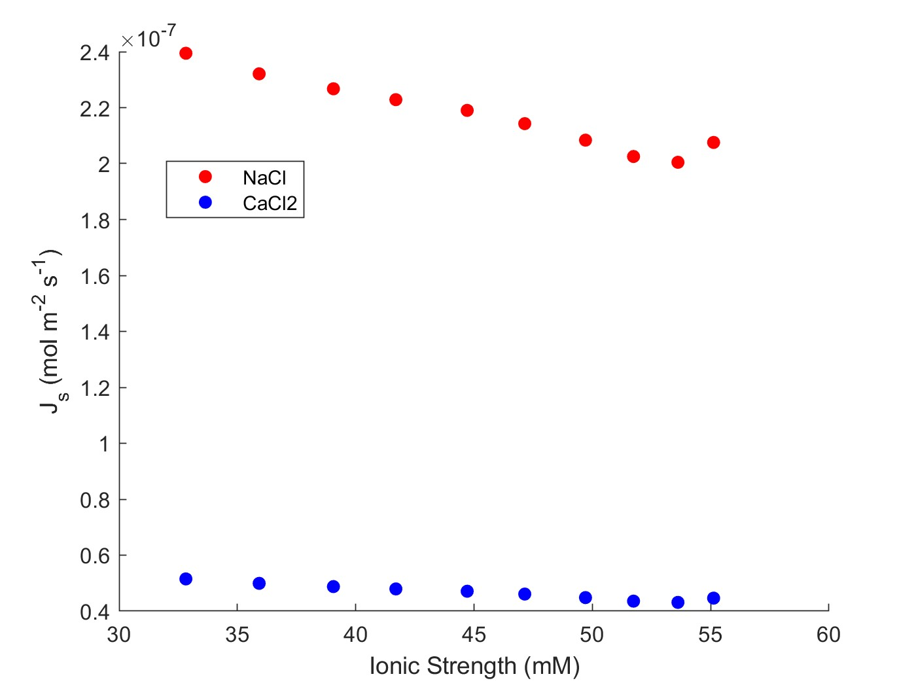
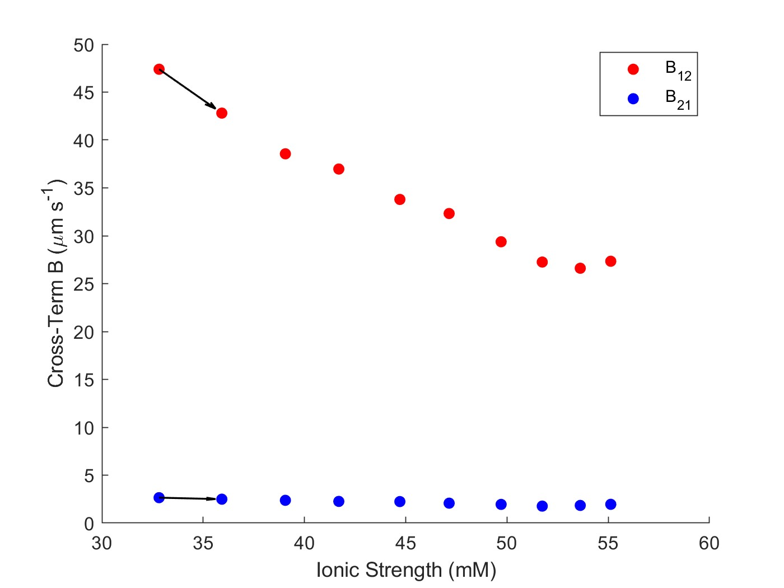
Estimate unknown values & identify general trends
Experiment: NF270_MC2_05.08.24_E1
Multicomponent: NaCl, CaCl2
Feed: 10 mM CaCl2
Diafiltrate: 4 mM CaCl2; 50 mM NaCl
Salts: NaCl, CaCl₂

Slide 9
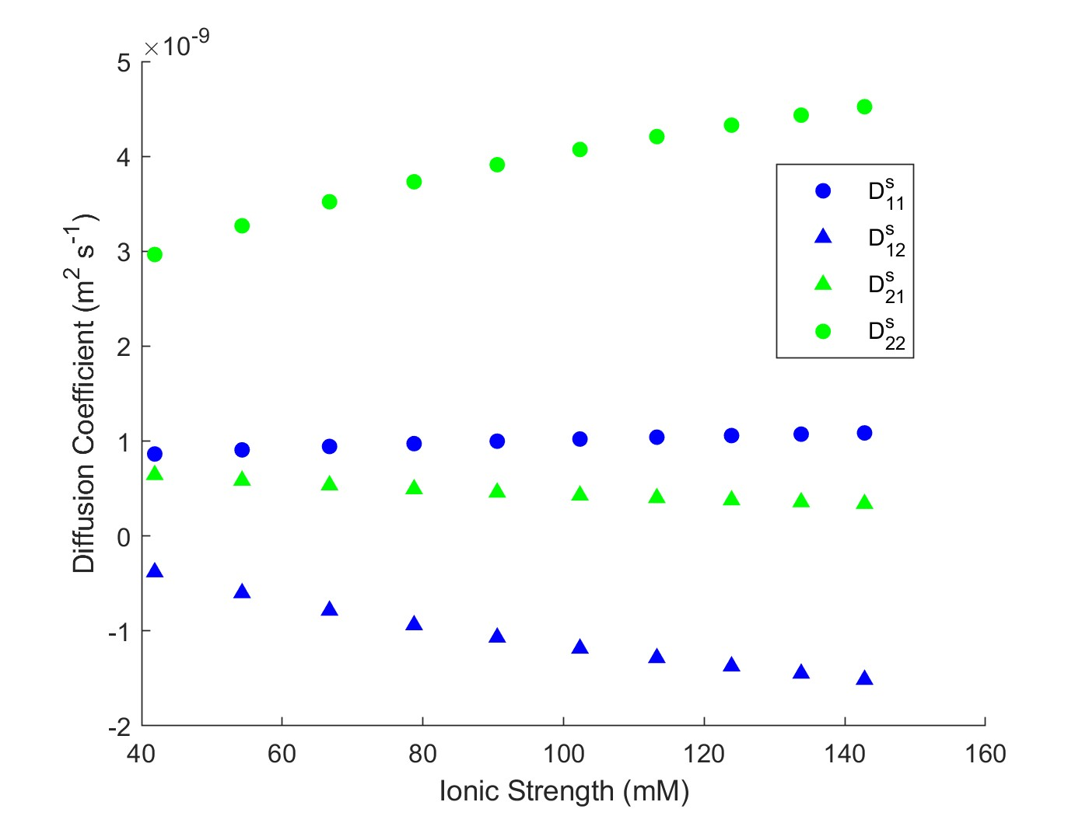
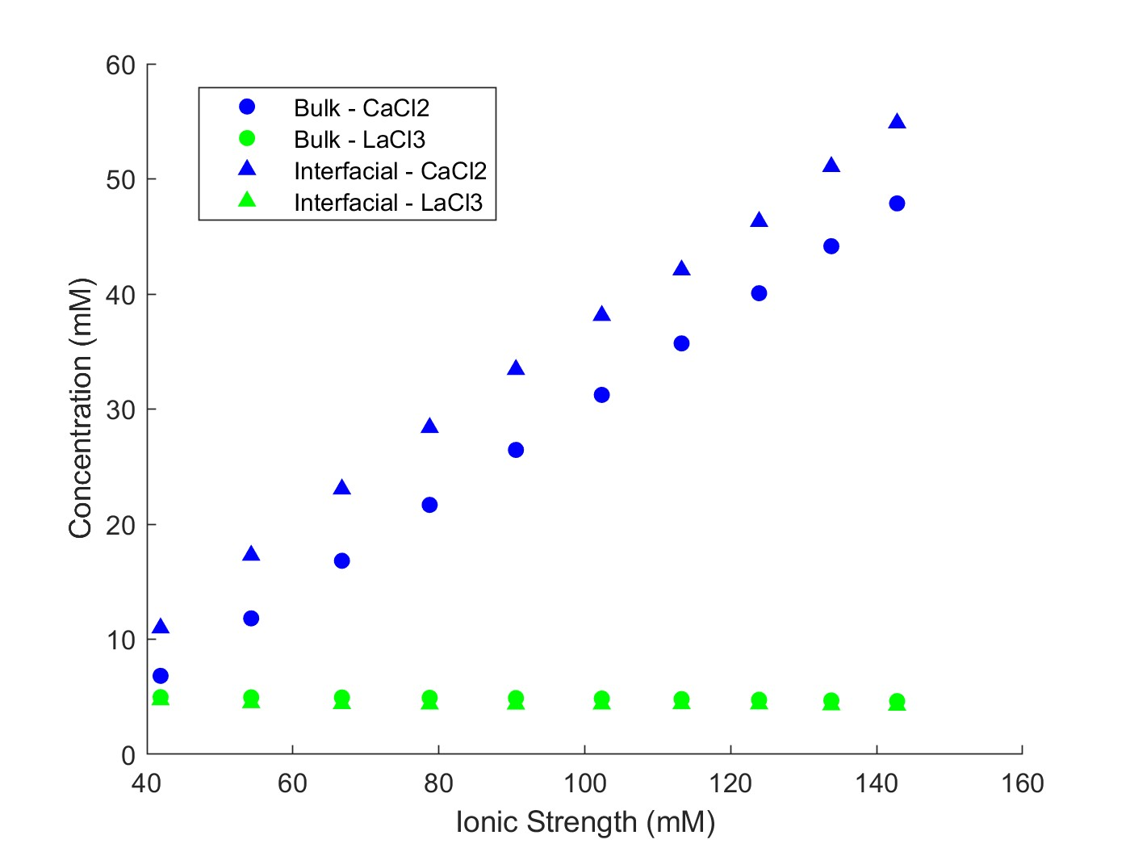
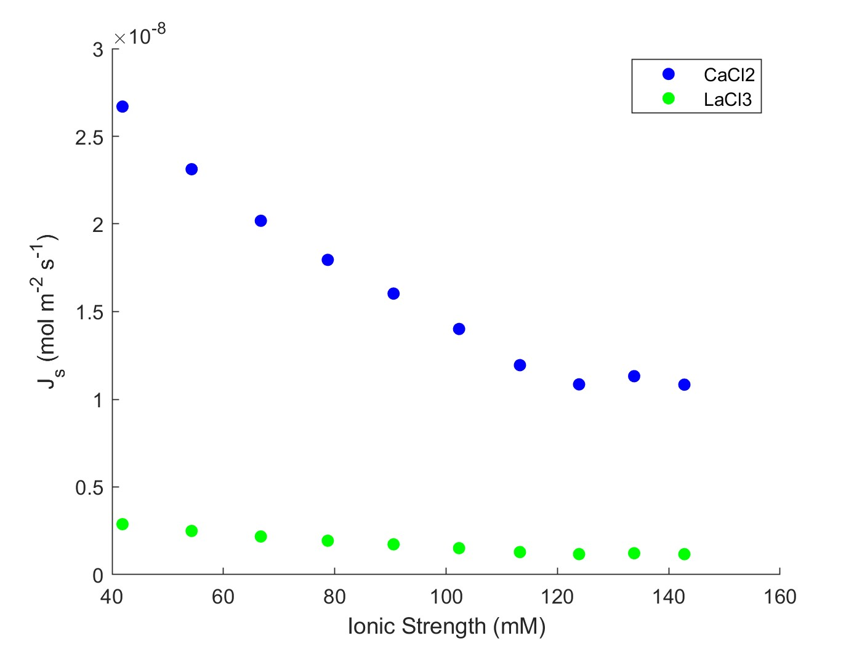
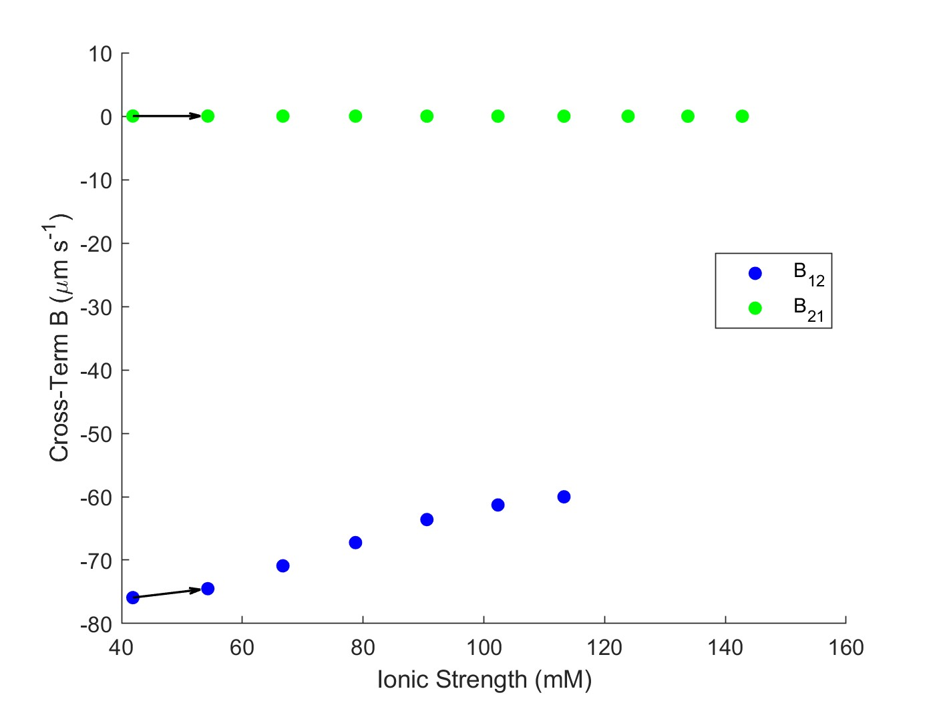
Estimate unknown values & identify general trends
Experiment: NF270_MC2_05.21.24_E6
Multicomponent: CaCl2, LaCl3
Feed: 5 mM LaCl3
Diafiltrate: 0.4 mM LaCl3; 50 mM CaCl2
Salts: CaCl₂ , LaCl₃

Slide 10
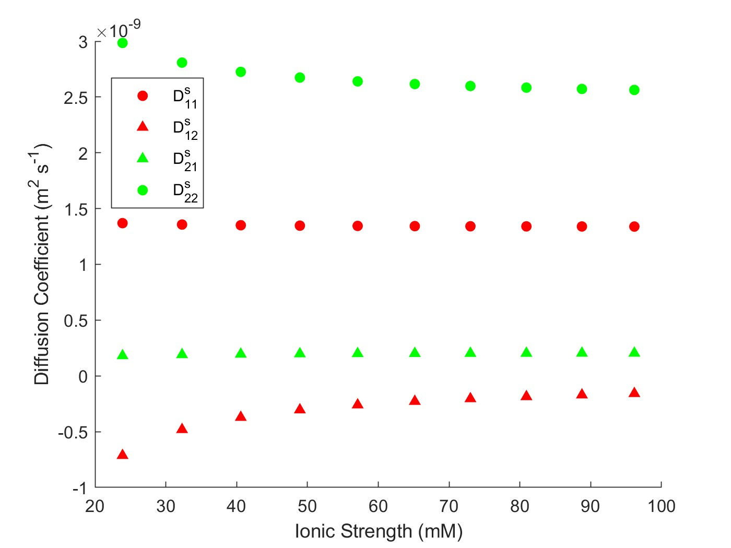
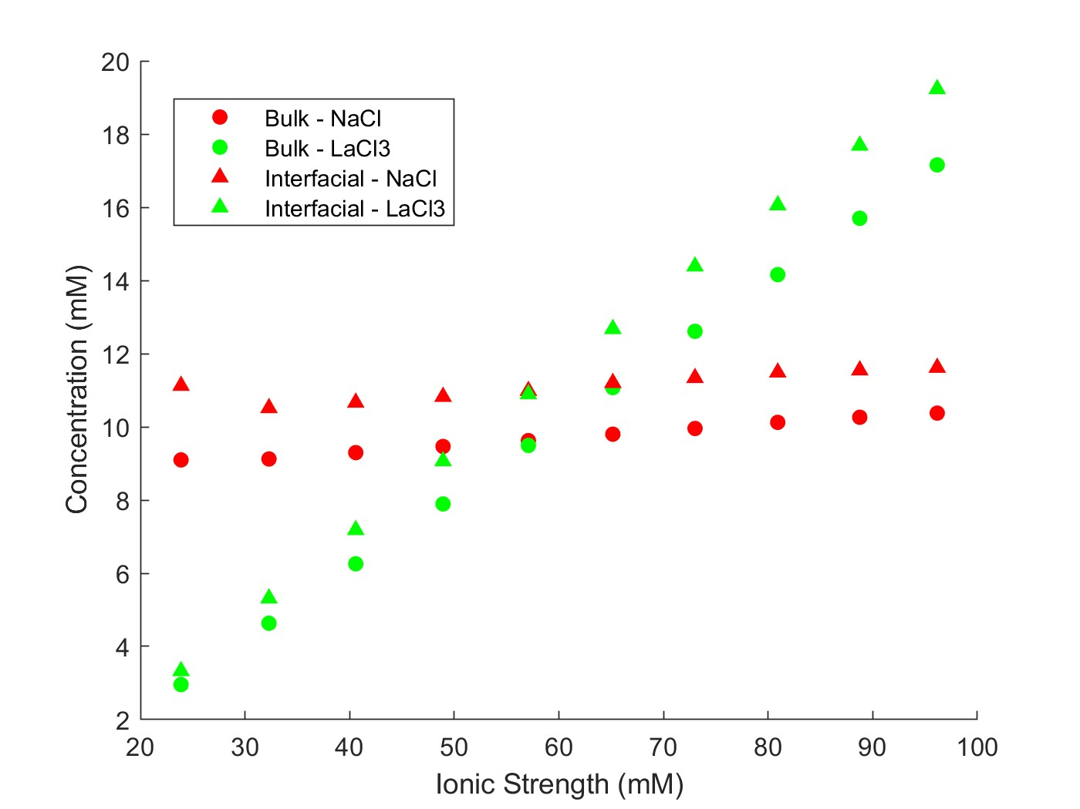
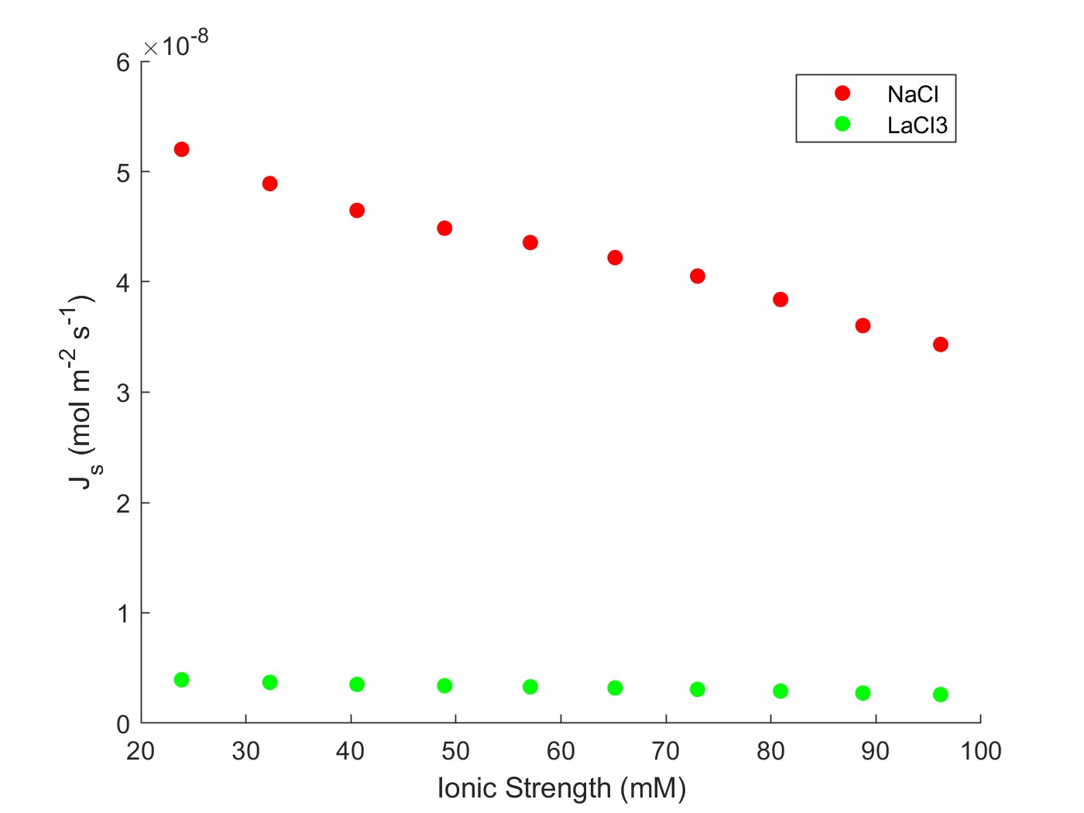
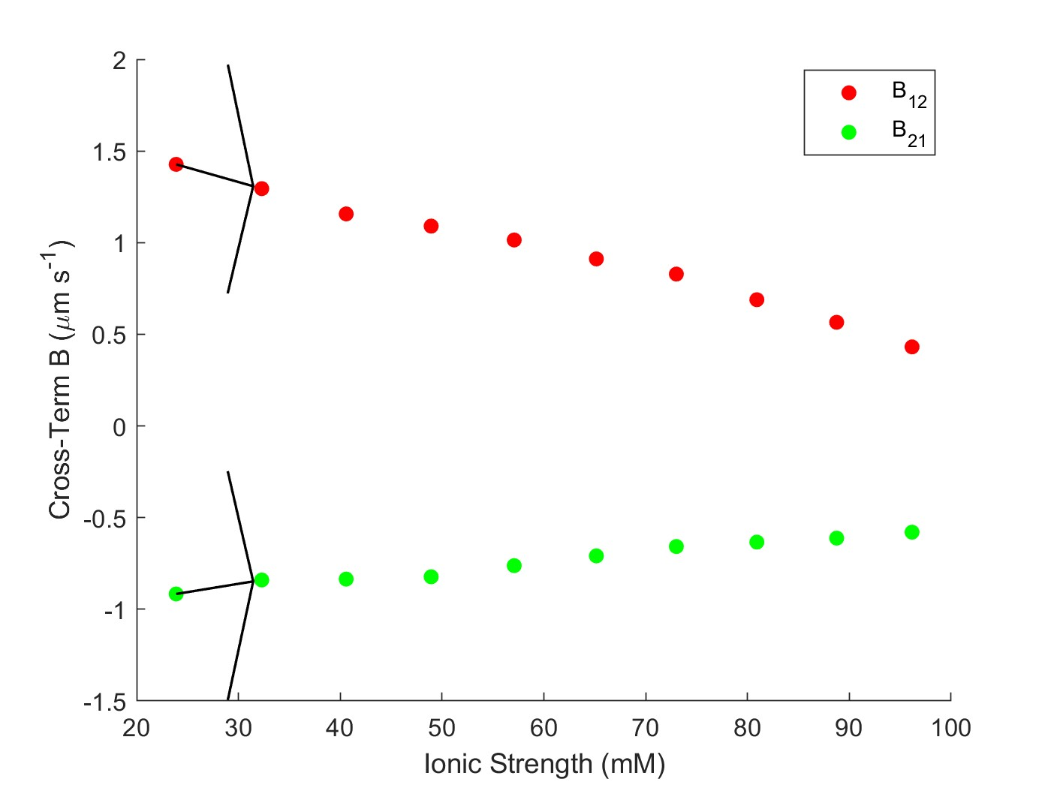
Estimate unknown values & identify general trends
Experiment: NF270_MC2_05.28.24_E11
Multicomponent: NaCl, LaCl3
Feed: 10 mM NaCl
Diafiltrate: 5 mM NaCl; 15 mM LaCl3
Salts: NaCl, LaCl₃

Slide 11
Next Steps & Upcoming Work
Now that $B_{ij}=\left[\begin{matrix}B_{11} & B_{12} \\ B_{21} & B_{11}\end{matrix}\right]$ can be estimated for each vial, using the same lumped-parameter approach:
Use $B_{ij}=\frac{D_{ij}H_{i}}{l}$, with some rearranging, estimate $H_{i}=\frac{D_{ij}}{B_{ij} l}.$
These are BOE estimates; A more rigorous analysis is required to deconvolute D and H “properly”.
What additional plots could help identify trends?
Bij vs Ionic Strength for similar experiments ran at low/high concentrations
Keshav: What is an attainable deadline for you to provide first-pass estimates of B using the DATA2 model?

Slide 12
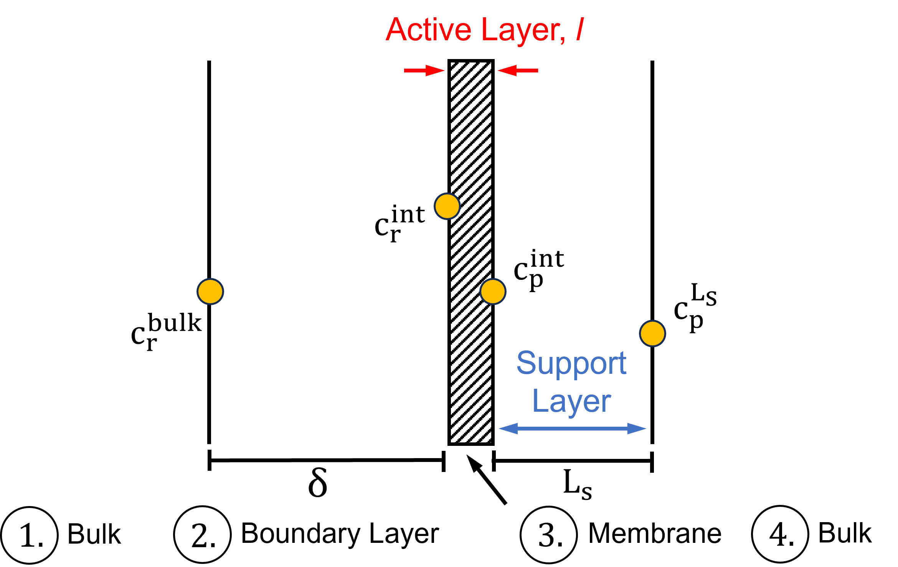
Figure S1 – Membrane Transport Schematic

Slide 13






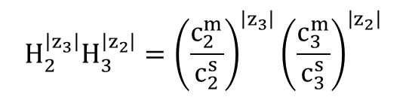



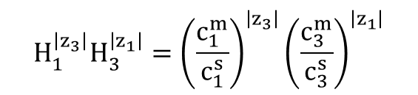





Transport and Thermodynamic Equations
two cations, one anion
Bulk
$$j_{1}^{s}=c_{1}^{s}J_{w}+∇c_{1}^{s}\left(D_{11}\right)+∇c_{2}^{s}\left(D_{12}\right)$$
$$j_{2}^{s}=c_{2}^{s}J_{w}+∇c_{1}^{s}\left(D_{21}\right)+∇c_{2}^{s}\left(D_{22}\right)$$
$$j_{3}^{s}=c_{3}^{s}J_{w}+D_{31}^{s}∇c_{1}^{s}+D_{32}^{s}∇c_{2}^{s}$$
Boundary Layer
$$J_{w}c_{p,1}^{s}=c_{1}^{s}J_{w}+∇c_{1}^{s}\left(D_{11}^{s}\right)+∇c_{2}^{s}\left(D_{12}^{s}\right)$$
$$J_{w}c_{p,2}^{s}=c_{2}^{s}J_{w}+∇c_{1}^{s}\left(D_{21}^{s}\right)+∇c_{2}^{s}\left(D_{22}^{s}\right)$$
$$J_{w}c_{p,3}^{s}=c_{3}^{s}J_{w}+∇c_{1}^{s}\left(D_{31}^{s}\right)+∇c_{2}^{s}\left(D_{32}^{s}\right)$$
Membrane: $χ$ is found in each term
$$j_{1}^{m}=c_{1}^{m}J_{w}+∇c_{1}^{m}\left(D_{11}\right)+∇c_{2}^{m}\left(D_{12}\right)$$
$$j_{2}^{m}=c_{2}^{m}J_{w}+∇c_{1}^{m}\left(D_{21}\right)+∇c_{2}^{m}\left(D_{22}\right)$$
$$j_{3}^{m}=c_{3}^{m}J_{w}+D_{31}^{m}∇c_{1}^{m}+D_{32}^{m}∇c_{2}^{m}$$
$$H_{1}^{\left|z_{3}\right|}H_{3}^{\left|z_{1}\right|}={\left(\frac{c_{1}^{m}}{c_{1}^{s}}\right)}^{\left|z_{3}\right|}{\left(\frac{c_{3}^{m}}{c_{3}^{s}}\right)}^{\left|z_{1}\right|}$$
$$H_{2}^{\left|z_{3}\right|}H_{3}^{\left|z_{2}\right|}={\left(\frac{c_{2}^{m}}{c_{2}^{s}}\right)}^{\left|z_{3}\right|}{\left(\frac{c_{3}^{m}}{c_{3}^{s}}\right)}^{\left|z_{2}\right|}$$

Slide 14

Full equations
Bulk
$$j_{1}^{s}=c_{1}^{s}J_{w}+∇c_{1}^{s}\left(\frac{{\left|z_{1}\right|}^{2}D_{1}^{s}D_{3}^{s}c_{1}^{s}+\left|z_{1}\right|\left|z_{3}\right|D_{1}^{s}D_{3}^{s}c_{1}^{s}−{\left|z_{2}\right|}^{2}{D_{1}^{s}D}_{2}^{s}c_{2}^{s}+\left|z_{2}\right|\left|z_{3}\right|D_{1}^{s}D_{3}^{s}c_{2}^{s}}{c_{1}^{s}\left({\left|z_{1}\right|}^{2}D_{1}^{s}−\left|z_{1}\right|\left|z_{3}\right|D_{3}^{s}\right)+c_{2}^{s}\left({\left|z_{2}\right|}^{2}D_{2}^{s}−\left|z_{2}\right|\left|z_{3}\right|D_{3}^{s}\right)}\right)+∇c_{2}^{s}\left(\frac{\left|z_{1}\right|\left|z_{2}\right|D_{1}^{s}D_{2}^{s}c_{1}^{s}+\left|z_{1}\right|\left|z_{2}\right|D_{1}^{s}D_{3}^{s}c_{1}^{s}}{c_{1}^{s}\left({\left|z_{1}\right|}^{2}D_{1}^{s}−\left|z_{1}\right|\left|z_{3}\right|D_{3}^{s}\right)+c_{2}^{s}\left({\left|z_{2}\right|}^{2}D_{2}^{s}−\left|z_{2}\right|\left|z_{3}\right|D_{3}^{s}\right)}\right)$$
$$j_{2}^{s}=c_{2}^{s}J_{w}+∇c_{1}^{s}\left(\frac{\left|z_{1}\right|\left|z_{2}\right|D_{1}^{s}D_{2}^{s}c_{2}^{s}+\left|z_{1}\right|\left|z_{2}\right|D_{2}^{s}D_{3}^{s}c_{2}^{s}}{c_{1}^{s}\left({\left|z_{1}\right|}^{2}D_{1}^{s}−\left|z_{1}\right|\left|z_{3}\right|D_{3}^{s}\right)+c_{2}^{s}\left({\left|z_{2}\right|}^{2}D_{2}^{s}−\left|z_{2}\right|\left|z_{3}\right|D_{3}^{s}\right)}\right)+∇c_{2}^{s}\left(\frac{{\left|z_{1}\right|}^{2}D_{1}^{s}D_{2}^{s}c_{1}^{s}+\left|z_{1}\right|\left|z_{3}\right|D_{2}^{s}D_{3}^{s}c_{1}^{s}−{\left|z_{2}\right|}^{2}{D_{2}^{s}D}_{3}^{s}c_{2}^{s}+\left|z_{2}\right|\left|z_{3}\right|D_{2}^{s}D_{3}^{s}c_{2}^{s}}{c_{1}^{s}\left({\left|z_{1}\right|}^{2}D_{1}^{s}−\left|z_{1}\right|\left|z_{3}\right|D_{3}^{s}\right)+c_{2}^{s}\left({\left|z_{2}\right|}^{2}D_{2}^{s}−\left|z_{2}\right|\left|z_{3}\right|D_{3}^{s}\right)}\right)$$
$$j_{3}^{s}=\frac{\left|z_{1}\right|}{\left|z_{3}\right|}j_{1}^{s}+\frac{\left|z_{2}\right|}{\left|z_{3}\right|}j_{2}^{s}$$
Boundary Layer
$$J_{w}c_{p,1}^{s}=c_{1}^{s}J_{w}+∇c_{1}^{s}\left(D_{11}^{s}\right)+∇c_{2}^{s}\left(D_{12}^{s}\right)$$
$$J_{w}c_{p,2}^{s}=c_{2}^{s}J_{w}+∇c_{1}^{s}\left(D_{21}^{s}\right)+∇c_{2}^{s}\left(D_{22}^{s}\right)$$
$$J_{w}c_{p,3}^{s}=c_{3}^{s}J_{w}+∇c_{1}^{s}\left(D_{31}^{s}\right)+∇c_{2}^{s}\left(D_{32}^{s}\right)$$

Slide 15
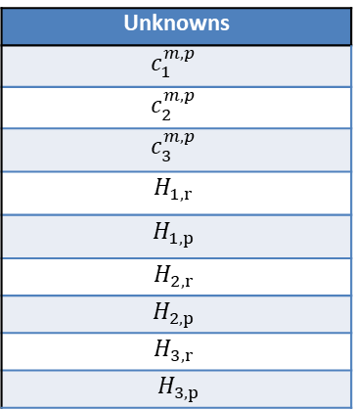

Full equations
Membrane
$$j_{1}^{m}=c_{1}^{m}J_{w}\left(1−\frac{\left|z_{1}\right|D_{1}^{m}χ}{c_{1}^{m}\left({\left|z_{1}\right|}^{2}D_{1}^{m}−\left|z_{1}\right|\left|z_{3}\right|D_{3}^{m}\right)+c_{2}^{m}\left({\left|z_{2}\right|}^{2}D_{2}^{m}−\left|z_{2}\right|\left|z_{3}\right|D_{3}^{m}\right)−\left|z_{3}\right|D_{3}^{m}χ}\right) +∇c_{1}^{m}\left(\frac{{\left|z_{1}\right|}^{2}D_{1}^{m}D_{3}^{m}c_{1}^{m}−\left|z_{1}\right|\left|z_{3}\right|{D_{1}^{m}D}_{3}^{m}c_{1}^{m}−{\left|z_{2}\right|}^{2}D_{1}^{m}D_{2}^{m}c_{2}^{m}−\left|z_{2}\right|\left|z_{3}\right|D_{1}^{m}D_{3}^{m}c_{2}^{m}−\left|z_{3}\right|D_{1}^{m}D_{3}^{m}χ}{c_{1}^{m}\left({\left|z_{1}\right|}^{2}D_{1}^{m}−\left|z_{1}\right|\left|z_{3}\right|D_{3}^{m}\right)+c_{2}^{m}\left({\left|z_{2}\right|}^{2}D_{2}^{m}−\left|z_{2}\right|\left|z_{3}\right|D_{3}^{m}\right)−\left|z_{3}\right|D_{3}^{m}χ}\right)+∇c_{2}^{m}\left(\frac{\left|z_{1}\right|\left|z_{2}\right|D_{1}^{m}D_{2}^{m}c_{1}^{m}−\left|z_{1}\right|\left|z_{2}\right|D_{1}^{m}D_{3}^{m}c_{1}^{m}}{c_{1}^{m}\left({\left|z_{1}\right|}^{2}D_{1}^{m}−\left|z_{1}\right|\left|z_{3}\right|D_{3}^{m}\right)+c_{2}^{m}\left({\left|z_{2}\right|}^{2}D_{2}^{m}−\left|z_{2}\right|\left|z_{3}\right|D_{3}^{m}\right)−\left|z_{3}\right|D_{3}^{m}χ}\right)$$
$$j_{2}^{m}=c_{2}^{m}J_{w}\left(1−\frac{\left|z_{2}\right|D_{2}^{m}χ}{c_{1}^{m}\left({\left|z_{1}\right|}^{2}D_{1}^{m}−\left|z_{1}\right|\left|z_{3}\right|D_{3}^{m}\right)+c_{2}^{m}\left({\left|z_{2}\right|}^{2}D_{2}^{m}−\left|z_{2}\right|\left|z_{3}\right|D_{3}^{m}\right)−\left|z_{3}\right|D_{3}^{m}χ}\right)+∇c_{1}^{m}\left(\frac{\left|z_{1}\right|\left|z_{2}\right|D_{1}^{m}D_{2}^{m}c_{2}^{m}−\left|z_{1}\right|\left|z_{2}\right|D_{1}^{m}D_{3}^{m}c_{2}^{m}}{c_{1}^{m}\left(z_{1}^{2}D_{1}^{m}−z_{1}z_{3}D_{3}^{m}\right)+c_{2}^{m}\left(z_{2}^{2}D_{2}^{m}−z_{2}z_{3}D_{3}^{m}\right)−z_{3}D_{3}^{m}χ}\right)+∇c_{2}^{m}\left(\frac{{\left|z_{1}\right|}^{2}D_{1}^{m}D_{2}^{m}c_{1}^{m}−\left|z_{1}\right|\left|z_{3}\right|{D_{2}^{m}D}_{3}^{m}c_{1}^{m}−{\left|z_{2}\right|}^{2}D_{2}^{m}D_{3}^{m}c_{2}^{m}−\left|z_{2}\right|\left|z_{3}\right|D_{2}^{m}D_{3}^{m}c_{2}^{m}−\left|z_{3}\right|D_{2}^{m}D_{3}^{m}χ}{c_{1}^{m}\left(z_{1}^{2}D_{1}^{m}−z_{1}z_{3}D_{3}^{m}\right)+c_{2}^{m}\left(z_{2}^{2}D_{2}^{m}−z_{2}z_{3}D_{3}^{m}\right)−z_{3}D_{3}^{m}χ}\right)$$
$$j_{3}^{m}=\frac{\left|z_{1}\right|}{\left|z_{3}\right|}j_{1}^{m}+\frac{\left|z_{2}\right|}{\left|z_{3}\right|}j_{2}^{m}$$
Unknowns
$$c_{1}^{m,p}$$
$$c_{2}^{m,p}$$
$$c_{3}^{m,p}$$
$$H_{1,r}$$
$$H_{1,p}$$
$$H_{2,r}$$
$$H_{2,p}$$
$$H_{3,r}$$
$H_{3,p}$
Rigorous analysis:
Partition coefficients and membrane-phase concentrations can also be split up into retentate side/permeate side.

